Slide 1
LADM – Paper Figures
Version 28th May 2022

Slide 2
Tomas P02
Ownership Right02
WR02
WR08
Elisabeth P03
Ownership Right03
WR10

Slide 3
Tomas P02
½ Ownership Right02
WR02
WR08
Elisabeth P03
½ Ownership Right02
WR10

Slide 4
Tomas P02
½ Ownership Right02
WR02
BAU02
WR08
Elisabeth P03
½ Ownership Right02
WR10

Slide 5
WR18-4
Figure C8
Monique P14
Ownership Right16
BAU12
WR18-5
WR18-6

Slide 6







People and their
Interrelationships
(Reality)
Common understanding
(Conceptual)
Land
(Reality)
Figure M0

Slide 7
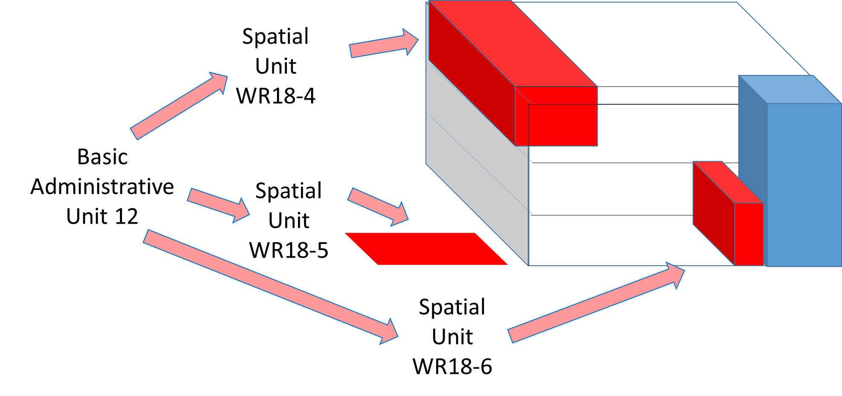
Monique: Party
Record of
“Ownership Right02”

Slide 8
Monique
Apartment
Parking Lot
Property
Laundry Room

Slide 9
Monique
Spatial
Unit
WR18-4
Basic
Administrative
Unit 12
Spatial
Unit
WR18-5
Spatial
Unit
WR18-6

Slide 10
Association of Owners P13
Ownership Right14
BAU10
WR18
WR18-4
Figure M9
Monique P14
Ownership Right16
BAU12
WR18-5
WR18-6
Ownership Right18
BAU14
WR01

Slide 11
Galaxy Properties P13
Ownership Right14
BAU10
WR18
WR18-4
Ownership Right19
BAU12
WR18-5
WR18-6
Monique P14
Ownership Right18
BAU14
WR01
Figure M9
(a)
Galaxy Properties P13
Ownership Right14
BAU10
WR18
WR18-4
WR18-5
WR18-6
Monique P14
Ownership Right18
BAU14
WR01
(b)

Slide 12
Galaxy Properties P13
Ownership Right14
BAU10
WR18
WR18-4
Figure M9
WR18-5
WR18-6
Monique P14
Ownership Right18
BAU14
WR01

Slide 13
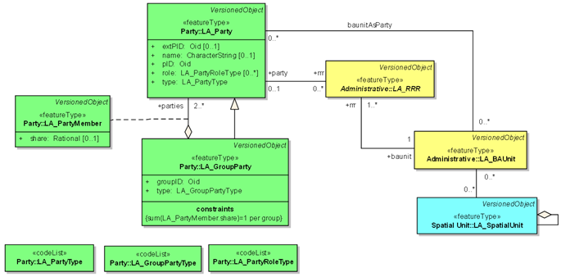
Member_1: LA_Party
GB01A
Grassybasin Community: LA_GroupParty
Ownership Right-R01
BAU-R01
Member_2: LA_Party
GB01B
…
Member_82: LA_Party
(a)
Elder_1: LA_Party
GW03A
Figure M1
Grassywoods Community: LA_GroupParty
Ownership Right-R03
BAU-R03
…
GW03B
Elder_9: LA_Party
(b)

Slide 14
Figure M2
Local community members register
Elder_1: LA_Party
Role: community representative
Member_1: LA_Party
Role: community member
Grassywoods Community: LA_GroupParty
…
Member_2: LA_Party
Role: community member
Elder_9: LA_Party
Role: community representative
…
Member_119: LA_Party
Role: community member

Slide 15
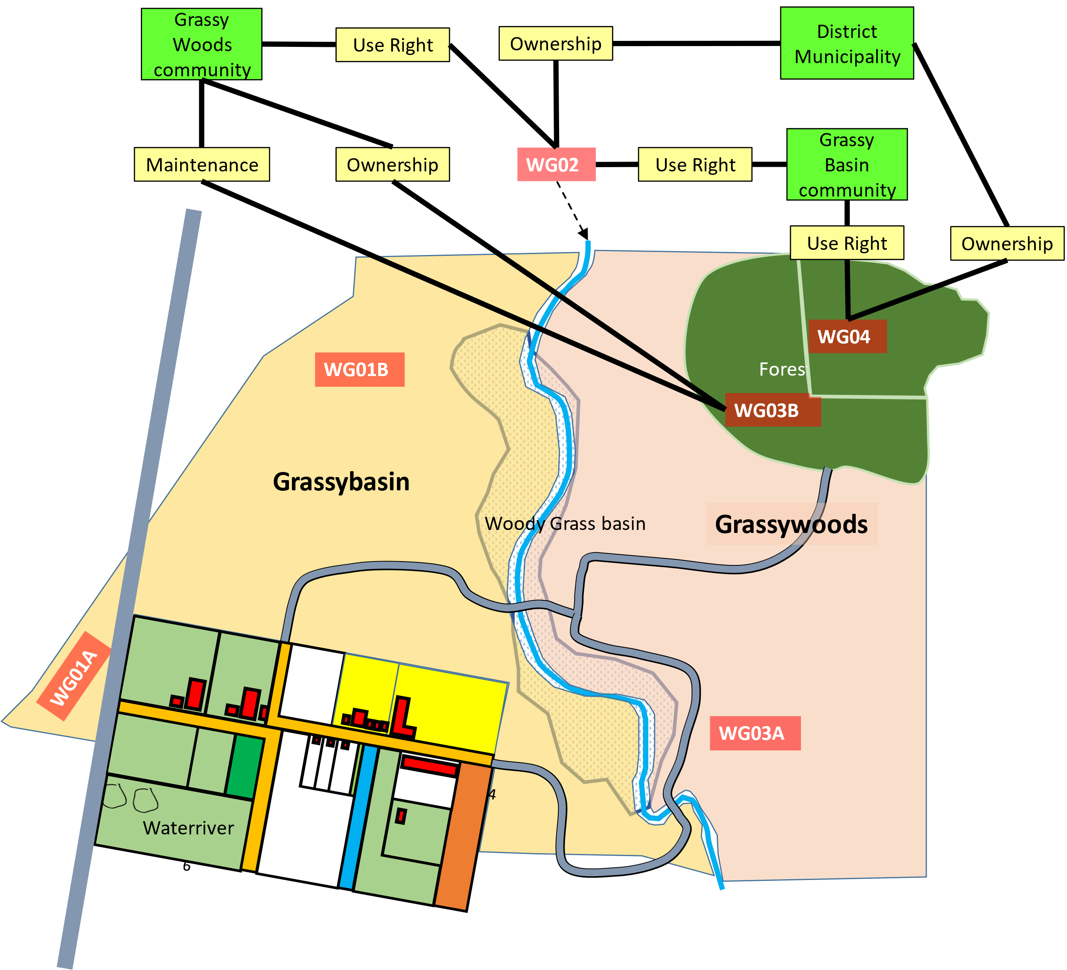
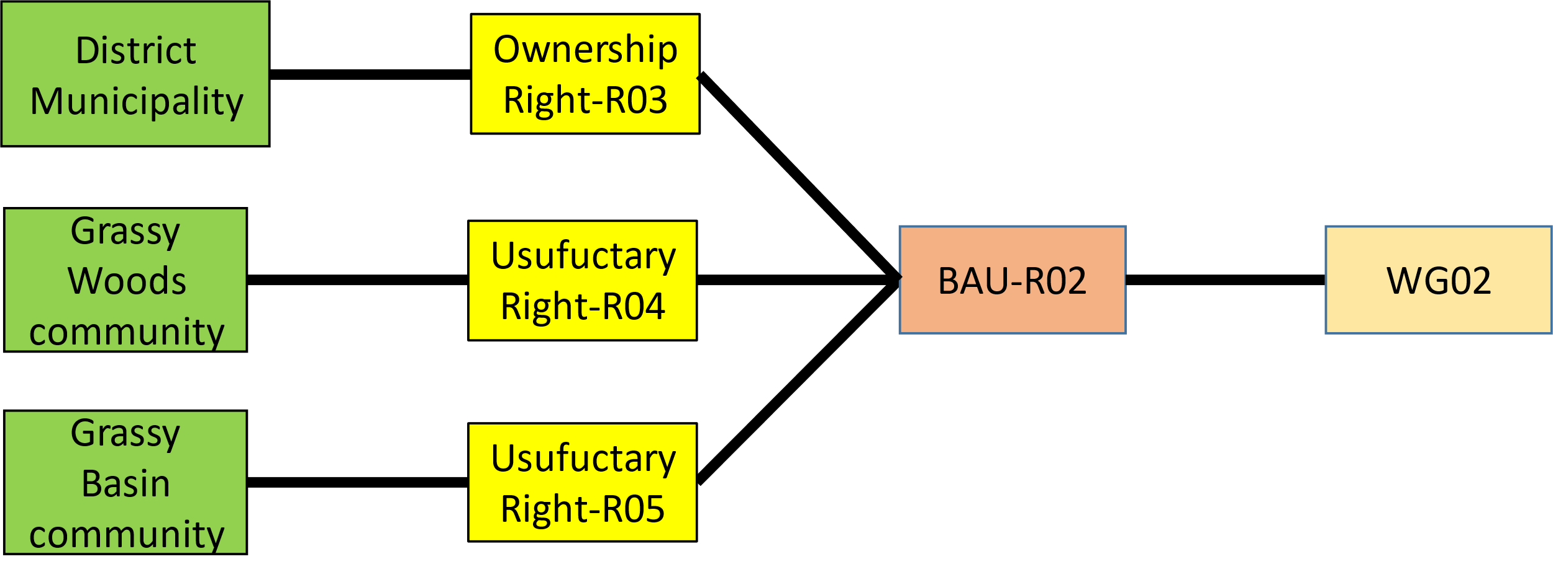
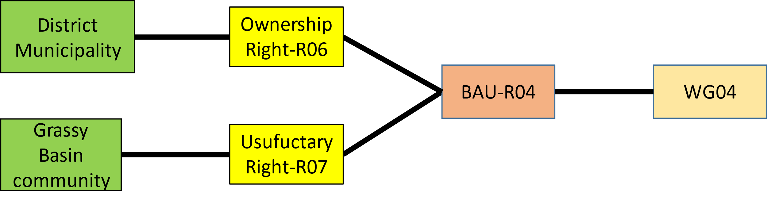
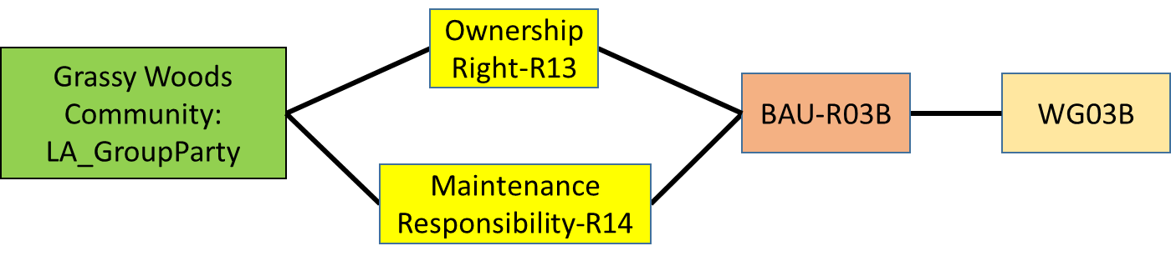
Figure M3

Slide 16
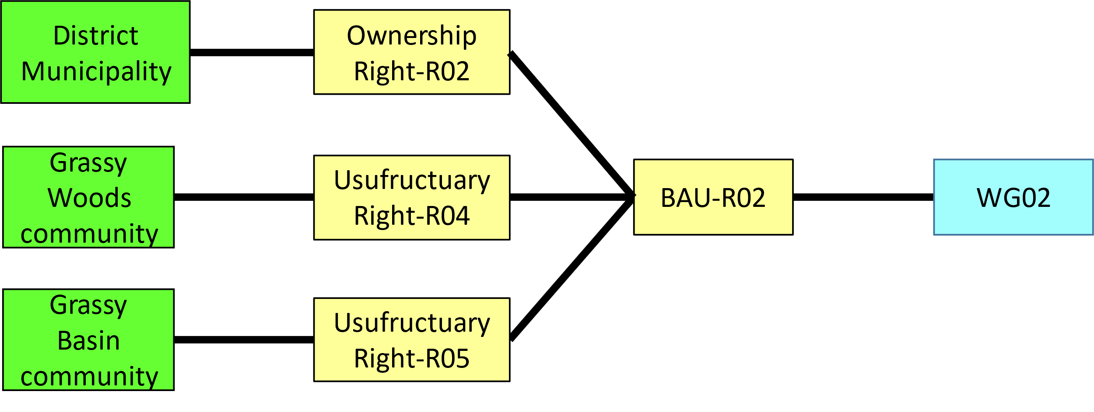
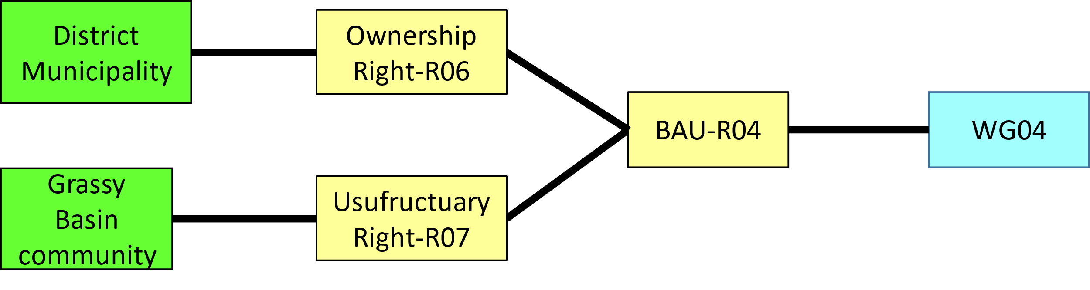
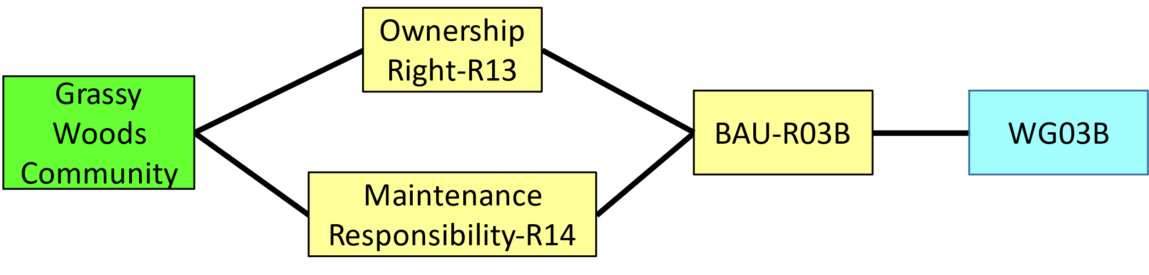
Figure M3

Slide 17







WG02
Forest land
WG04
WG01B
WG03B
Grassybasin
Woody Grass basin
Grassywoods
WG01A
WR02
WR02
WR04
WR05
WR05
WR06
WR01
WR06
WR01
WG03A
WR03
WR03
WR16
WR
15
WR16
WR
13
WR
15
WR
13
WR17
WR
14
WR17
WR
12
WR
14
WR
12
WR22
WR21
WR22
WR
11
WR21
WR
11
20
20
WR24
WR23
WR24
WR18
WR23
WR18
WR19
WR19
WR07
WR07
WR30
WR
09
WR30
WR
09
WR32
WR08
WR32
WR08
WR29
WR
10
WR29
WR
10
WR31
Waterriver
WR31
WR26
WR25
WR26
WR25
WR37
WR34
WR37
WR
28
WR34
WR27
WR
28
WR27
WR38
WR38
WR39
WR35
WR39
33
WR35
33
WR40
WR36
WR40
WR36

Slide 18




Grassy Woods community
District Municipality
Use Right
Ownership
Grassy Basin community
Maintenance
Ownership
WG02
Use Right
Use Right
Ownership
Forest land
WG04
WG01B
WG03B
Grassybasin
Woody Grass basin
Grassywoods
WG01A
WR02
WR02
WR04
WR05
WR05
WR06
WR01
WR06
WR01
WG03A
WR03
WR03
WR16
WR
15
WR16
WR
13
WR
15
WR
13
WR17
WR
14
WR17
WR
12
WR
14
WR
12
WR22
WR21
WR22
WR
11
WR21
WR
11
20
20
WR24
WR23
WR24
WR18
WR23
WR18
WR19
WR19
WR07
WR07
WR30
WR
09
WR30
WR
09
WR32
WR08
WR32
WR08
WR29
WR
10
WR29
WR
10
WR31
Waterriver
WR31
WR26
WR25
WR26
WR25
WR37
WR34
WR37
WR
28
WR34
WR27
WR
28
WR27
WR38
WR38
WR39
WR35
WR39
33
WR35
33
WR40
WR36
WR40
WR36

Slide 19
1. Registration of communities
Both Grassy Basin and Grassy Woods communities have use rights of the river’s water so the water body section covering the boundary between the two communities is registered as public land with use rights allocated to the two communities.
District Municipality
Ownership Right-R02
Grassy Woods community
Usufructuary Right-R04
BAU-R02
WG02
Grassy Basin community
Usufructuary Right-R05

Slide 20
1. Registration of communities
In addition, Grassy Basin community have use rights of the in public forest the two communities is registered as public land with use rights allocated to the two communities.
District Municipality
Ownership Right-R06
BAU-R04
WG04
Grassy Basin community
Usufructuary Right-R07

Slide 21
1. Registration of communities
There is a responsibility on Grassy Woods community to maintain the part of the forest in its territory which is protected under national law.
Grassy Woods Community: LA_GroupParty
Ownership Right-R03
BAU-R03A
WG03A
Ownership Right-R13
Grassy Woods Community
BAU-R03B
WG03B
Maintenance Responsibility-R14

Slide 22
Example – Community
Figure M4
Individual with permanent rights to activities in Forest WG04 based on being member of Grassybasin community. Individual with temporary rights to activities in Forest WG04 based on holding lease rental of plot in Grassybasin community.
Mwalimu: Party
Usufructuary Right-R15
Start-date
End-date
Rental –R16A
BAU-R06
WG07
<<dependency>>
Usufructuary Right-R16B lives as long as Rental-R16A
Mnandi: party
Usufructuary Right-R16B
BAU-R04
WG04

Slide 23
An alternative modeling strategy could use the BAUnit as a party where the rented plot has permanent rights while renter inherits rights on plot for rental period.
Figure M5
Mwalimu: Party
Usufructuary Right-R15
BAU-R04
WG04
<<constraint>>
Usufructuary Right-R16B lives as long as both BAU-R04 and BAU-R06 exist
Usufructuary Right-R16B
Start-date
End-date
Mnandi: party
BAU-R06
WG07
Rental –R16A
<<constraint>>
BAU-R06 plays the role of party in relation to Usufructuary Right-R16B

Slide 24
Mwalimu: Party
Usufructuary Right-R15
Mnandi: party
Usufructuary Right-R16B
BAU-R04
WG04
<<dependency>>
Usufructuary Right-R16B lives as long as Rental-R16A
Start-date
End-date
BAU-R06
WG07
Rental –R16A
rID (PK) | LA_Right_Type | beginLifespan | endLifespan
Right-R15 | Usufructuary | 2022-09-01 | –
Right-R16A | Rental | 2022-rainy-season-start | 2022-rainy-season-end
Right-R16B | Usufructuary | – | –
(a)
primaryRight(FK) | dependentRight (FK)
Right-R15 | Right-R16A
Right-R16A | Right-R16B
(b)

Slide 25
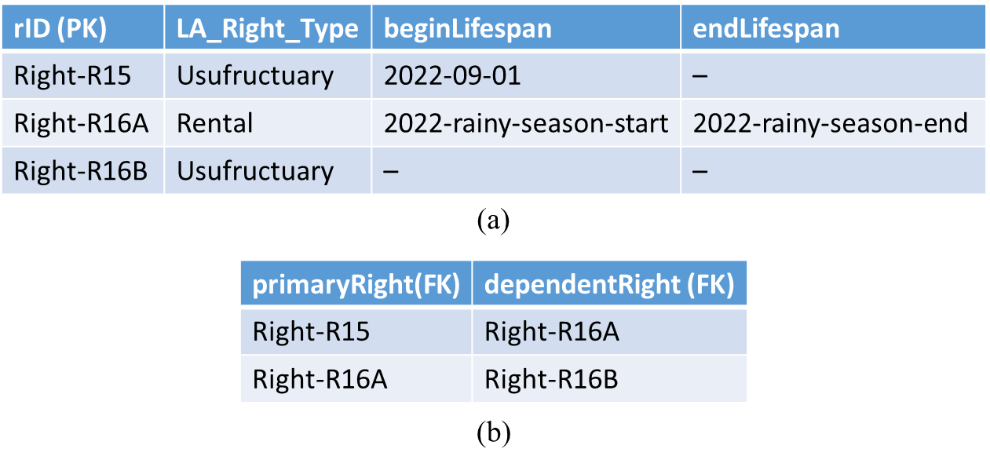

Slide 26
<<Constraint>>
Time interval for existence of Right-R15 must cover time interval for existence of Rental-R16A.
Start-date
End-date
Mwalimu: Party
Usufuctary Right-R15
Start-date
End-date
Spatial-Unit Level B
Mnandi: party
BAU-R06
WG07
Lease -R04
Rental-R16A
Grassy Basin community
Ownership Right-R05

Slide 27
Example – Communal water resources
Figure M7
Sergey: Party
Water Access Right-R59
BAU-R11
WG14
Water Access Right-R61
<<Note>>
Constructed water resource
<<Note>>
Sergey, a member of Grassywoods, has full access rights to both constructed and natural water sources. Ramon from Grassy Basin has domestic water use rights only on constructed water source BAU-R11
Domestic water use Right-R62
<<Note>>
Responsibility is fractional not full
<<Note>>
Natural water resource
Maintenance Responsibility-R63
Ramon: party
Water Access Right-R64
BAU-R12
WG15

Slide 28
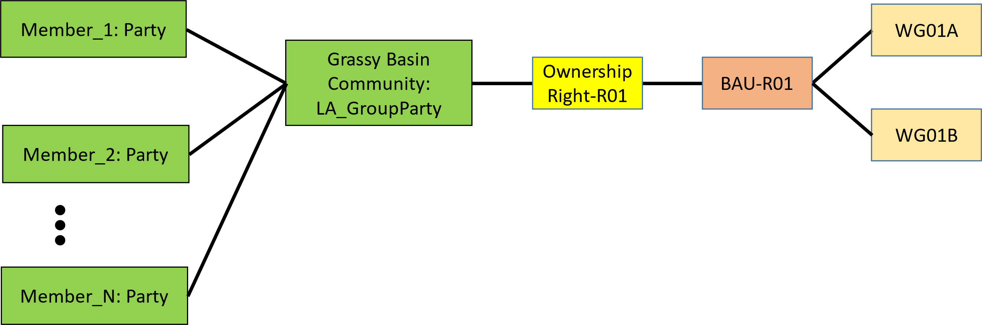
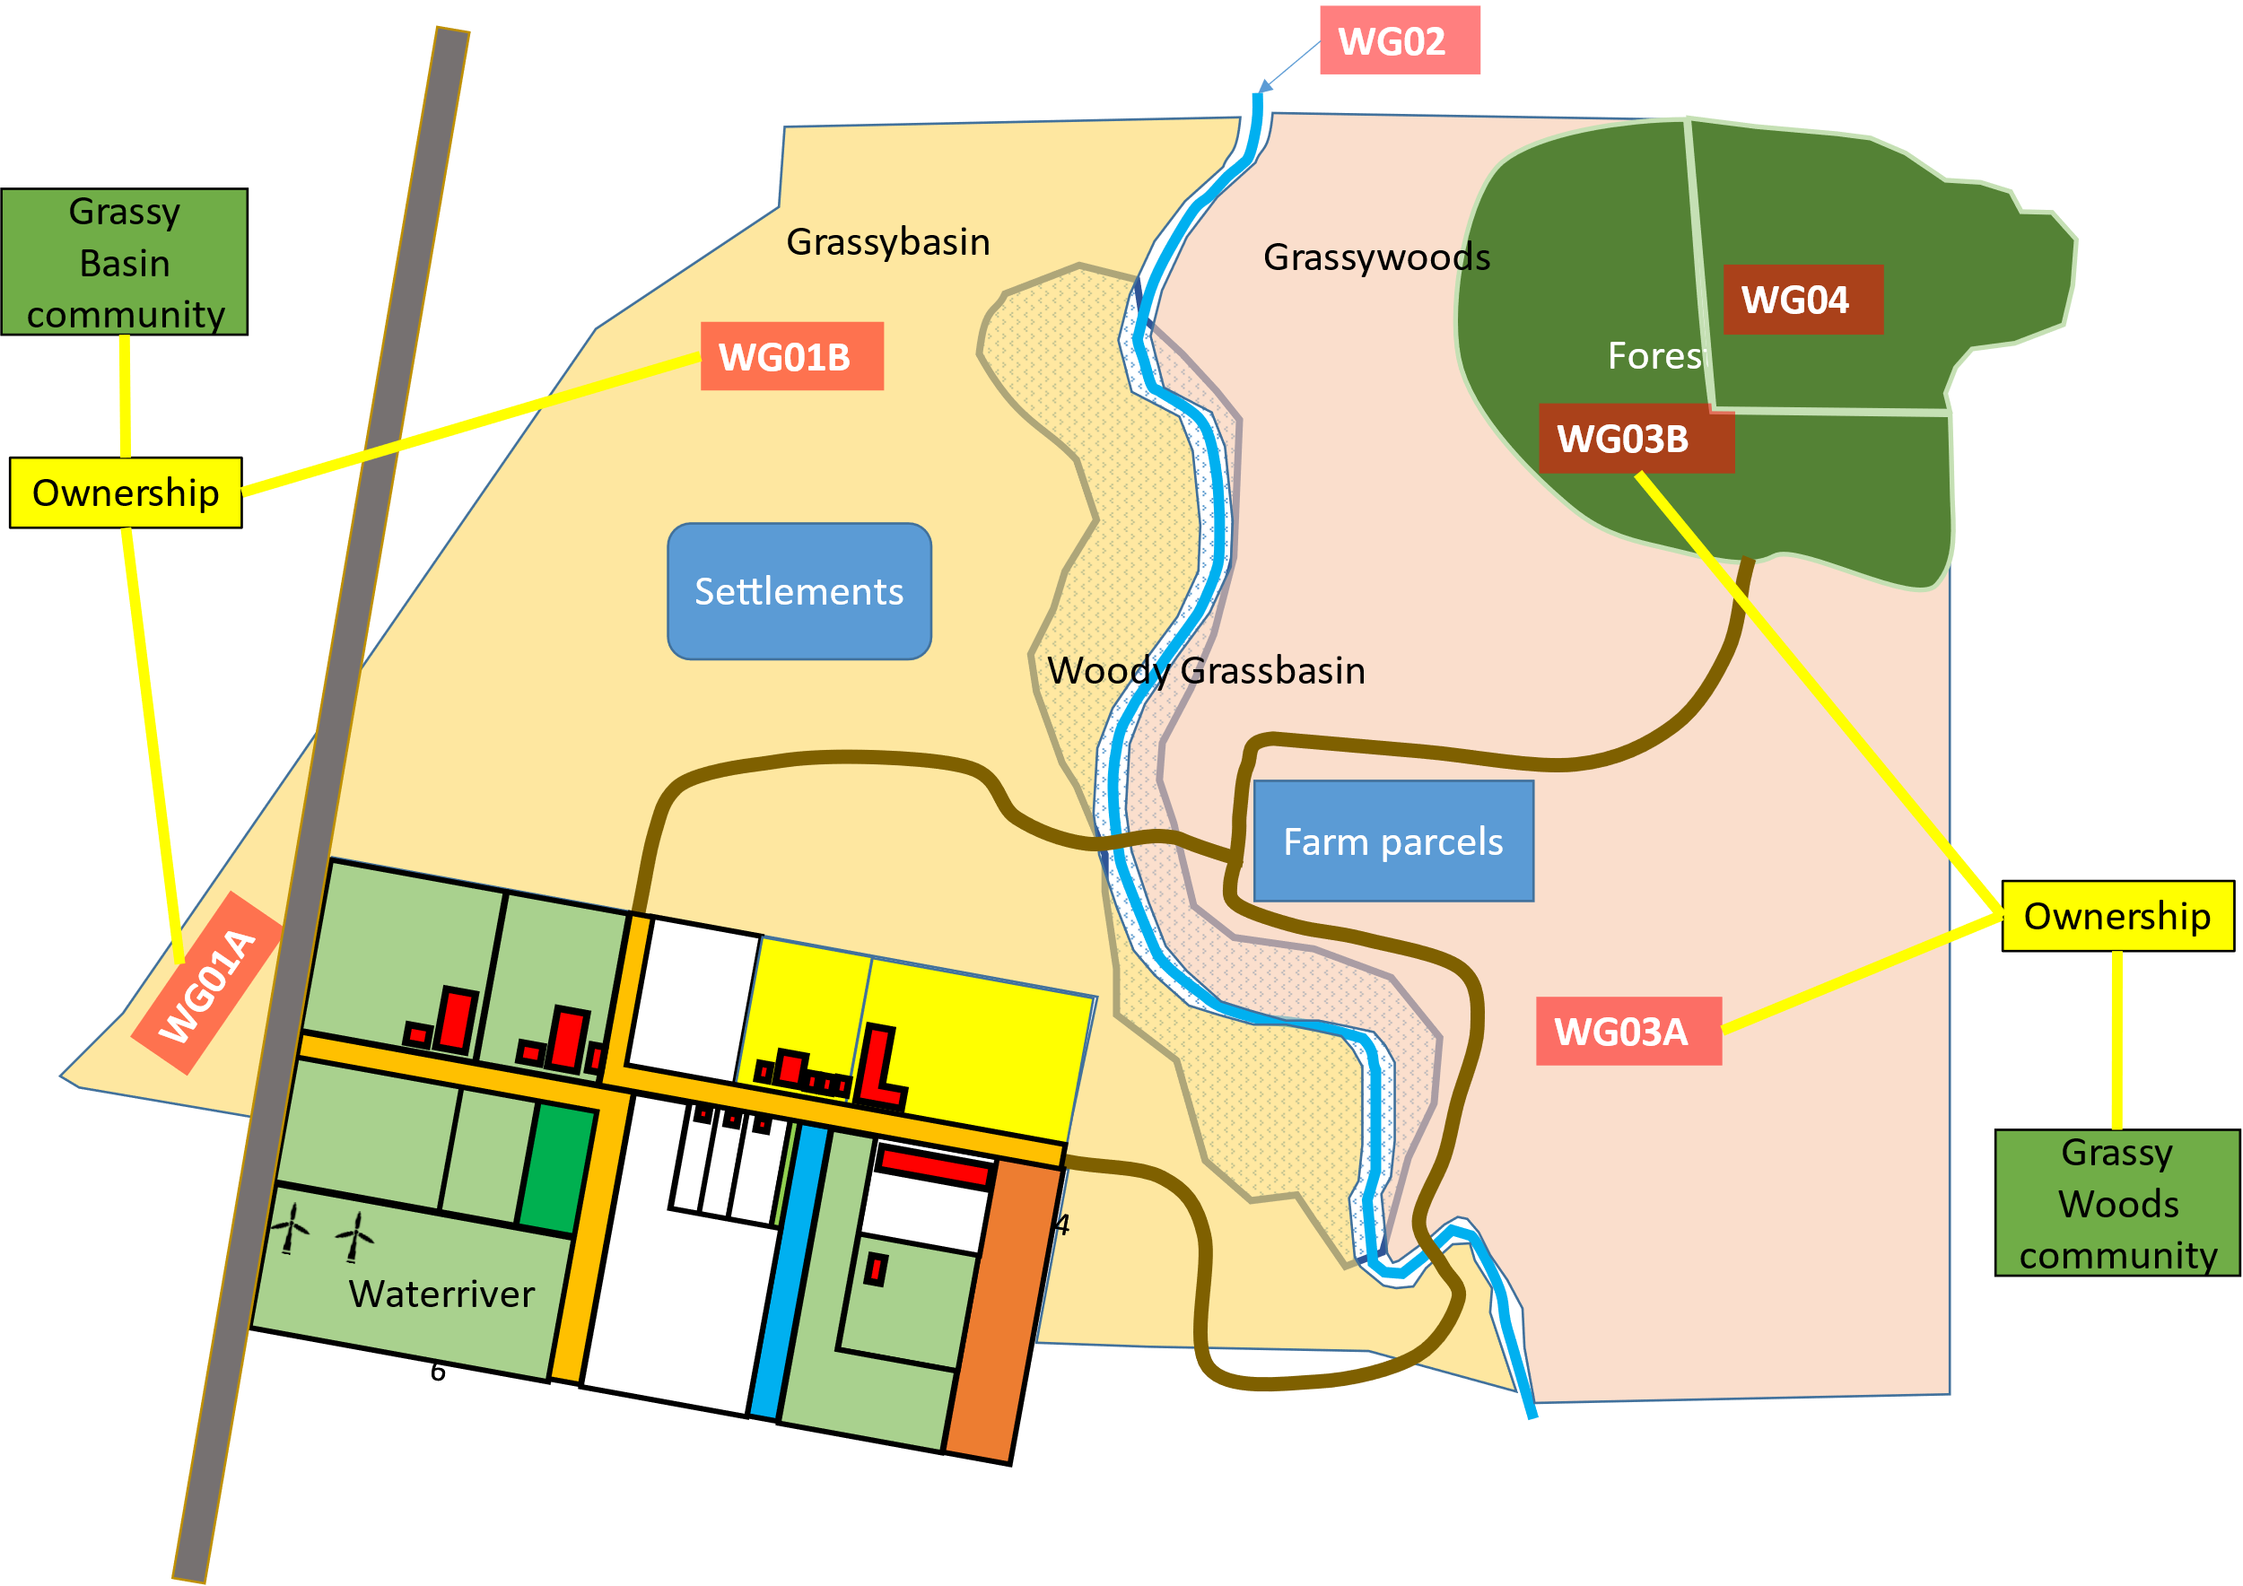
Community 1: Grassybasin community
GB02
Redesign the map of waterriver village – add a bit more curvature

Slide 29
NOTES ON INCLUDING OCL IN LAInfo MODELLING IN LADM
Use OCL to specify conditions under which rights are valid including temporal events.

Slide 30

Tomas: Party
Ownership Right02
WR10
Figure M0

